Slide 1
Knowledge raphbased Estimationof uNcertaintyin PhEno -typPisation And GenoType inspired RepHenotypisation
Hier steht eine optionale Subheadline
knowledge
G
E
N
E
P A T H
raph based
stimation of
u
certainty in
ph
no-
ty
isation
Dr. med. Alexander Mordhorst
Application: JDCS4rare
nd
geno
ype inspired
re-p
enotypisation

Slide 2
Outline
Motivation
Planned graph-architecture and future perspectives
Exploring what´s already possible

Slide 3
Motivation
Clinical motivation
Diagnostic cap still between 30-50%
Changing this will heavily rely on deep phenotypisation
Standardization and data-driven guidelines still lacking
Scientific motivation
Linking a patient phenotype to genevariants remains a problem
Tools like CADA, Phrank and Phevor already use knowledge-graphs for this task, but
Try to model an underlying biological association
Use a score as model output
This Project aims to build a knowledge-graph based model of phenotype-genevariant-association, but rather modelling the intuition of the expert clinical genomics specialist in order to assist in data-driven phenotypisation and variant prioritization.

Slide 4
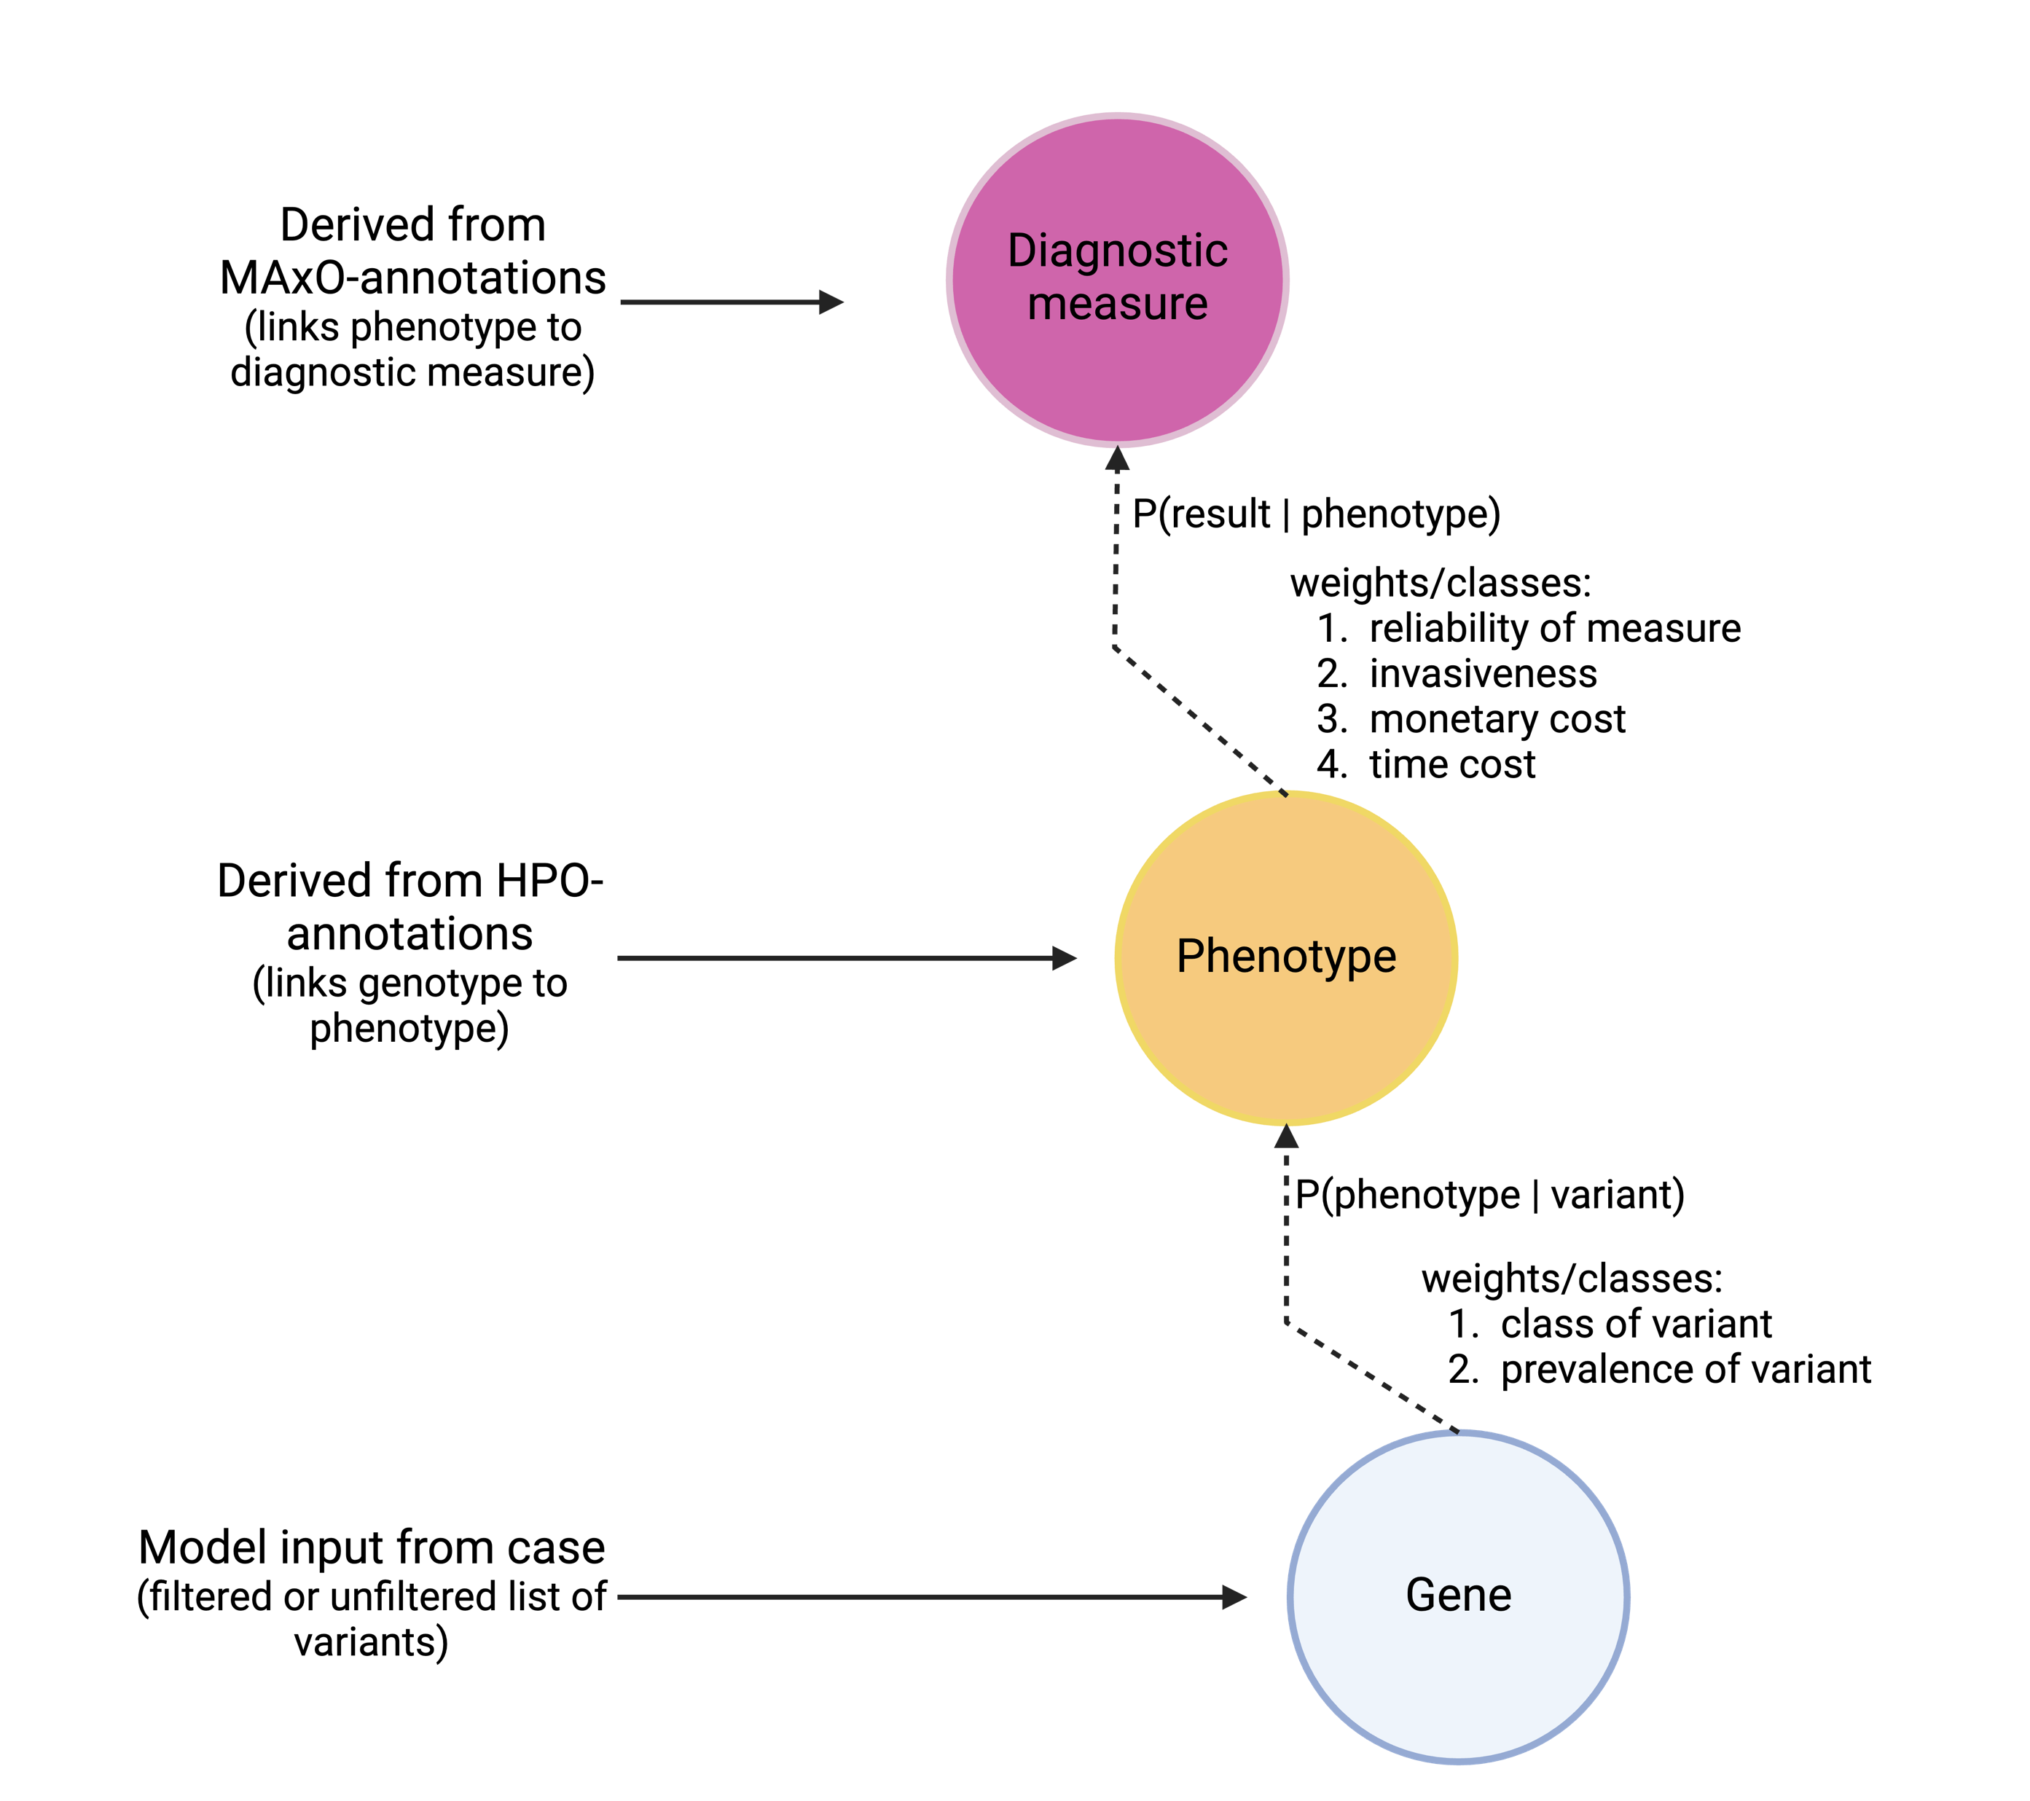
Planned graph-architecture and future perspectives
Questions this might answer:
How complex is the diagnostic case at hand?
Which variants are linked to the highest number of phenotypes?
Which diagnostic measure will result in the hightest information gain?
How „costly“ is this measure?
Is there a logical alternative?

Slide 5
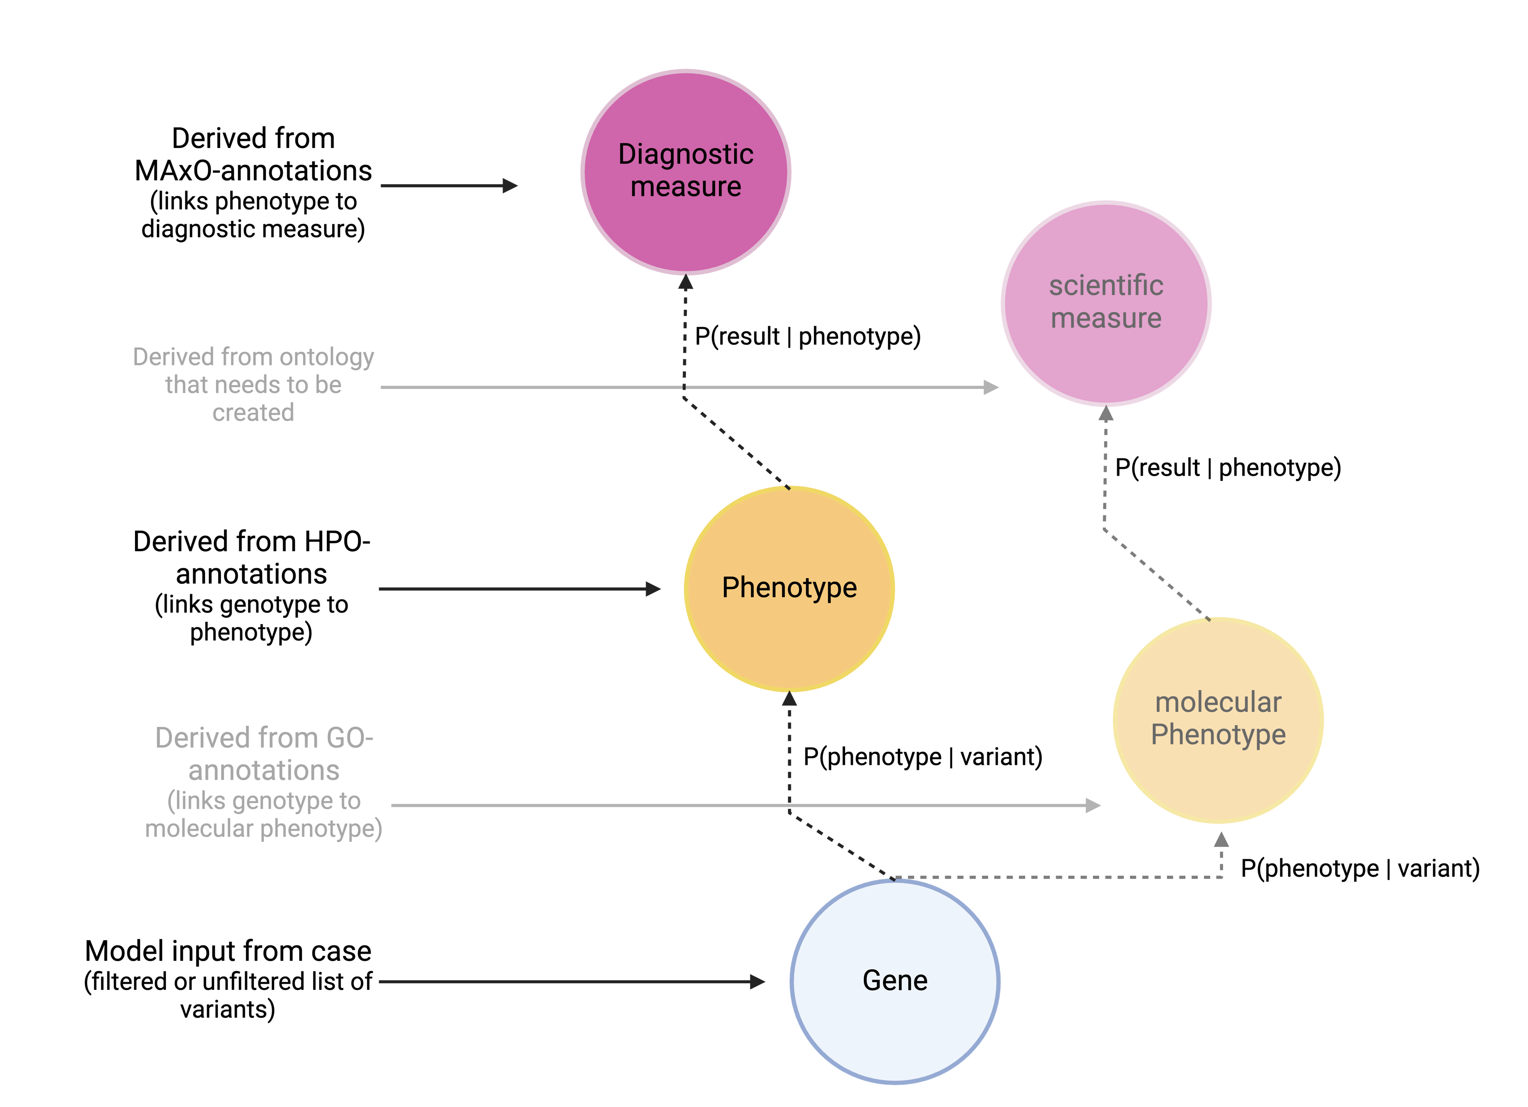
Planned graph-architecture and future perspectives
Questions this might answer:
Are there as of yet unknown disease genes that have a high prior probability and might be eligible for downstream analysis?
Which scientific measurements will yield the highest information gain?

Slide 6
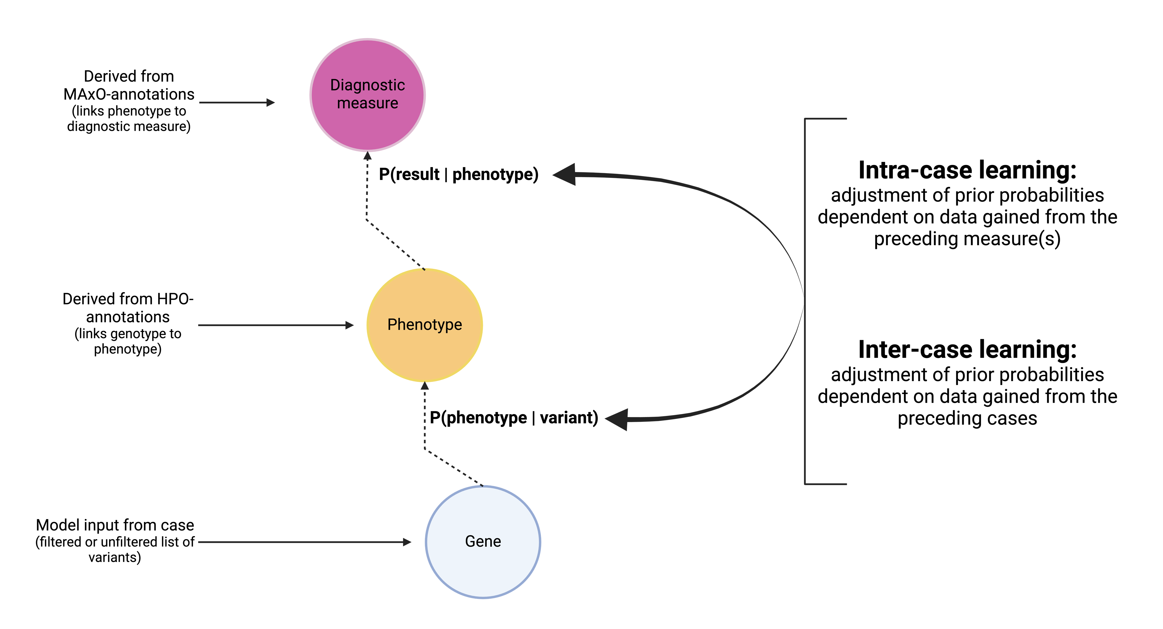
Planned graph-architecture and future perspectives

Slide 7
Exploring what´s already possible

